Slide 1
Cove Software, LLC
Michael Maloney
mike@covesw.com
410-715-1117
web: www.covesw.com

Slide 2
Cove Software, LLC
Founded in March, 2012
As of January, 2014, Cove is unencumbered by non-compete agreements.
Seeking to serve DCS Community through:
  OpenDCS Support
  Custom integration & software development projects
  Collaboration with other vendors on complete systems
  Training

Slide 3
OpenDCS 6.0
Released to Corps of Engineers in April, 2014
Full implementation of LRGS, DECODES, Computation Processor, and other Tools
Backwardly Compatible with other releases of LRGS and DECODES
Many new features, and many more planned over the next year.
Goal: Make data reception, decoding, and processing as painless and automatic as possible.

Slide 4
OpenDCS 6.0 Features
LRGS Data Retrieval via DOMSAT, GOES DRGS (DAMS-NT) GOES-LRIT, Iridium SBD (Short Burst Data), NOAAPORT, and DDS (Network Backup).
New DDS (DCP Data Service) version 12 supports specification of GOES self-timed vs. random and other server side data sources.
DECODES Database can be XML, OpenDCS Schema under PostgreSQL or Oracle, CWMS/Oracle, or USBR HDB/Oracle
CCP (Computation Processor) compatible with CWMS 2.1, CWMS 3.0, and USBR/HDB
Reworked Documentation

Slide 5
More OpenDCS 6.0 Features
Retrieval/Decoding statistics stored in the database.
  Tools to query by station, time-range, and/or routing spec
Platform specific debug-level allows you to monitor troublesome platforms in greater detail without flooding the log files.
GUI to monitor background processes and display events from them in real-time.
  Computation Processes, Routing Specs, Routing Scheduler, Others.

Slide 6
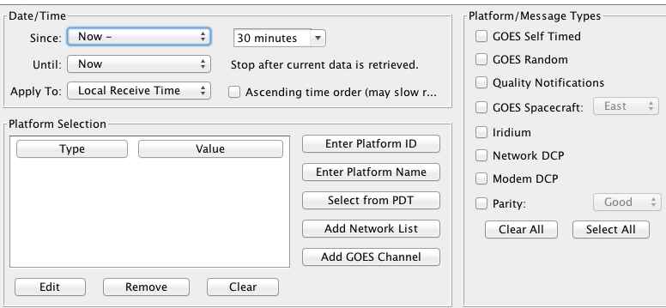
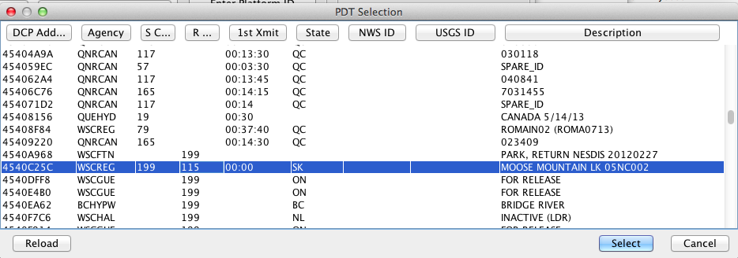
New Search Criteria Editor with PDT Access

Slide 7
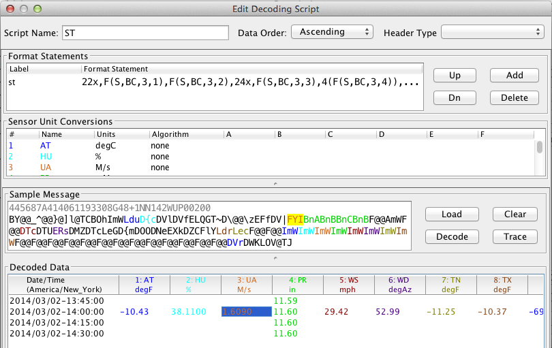
Ease-of-Use Improvements for DECODES Script Editing

Slide 8
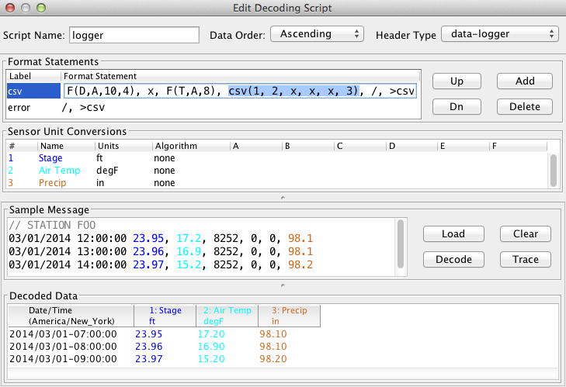
New DECODES Functions for CSV and Self-Describing Data

Slide 9
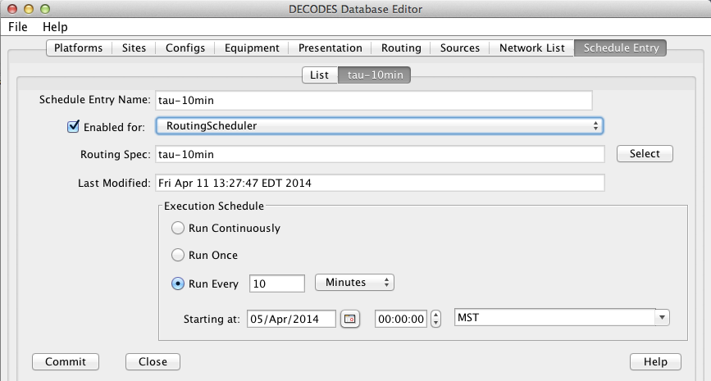
New Database-Resident Routing Spec Scheduler

Slide 10
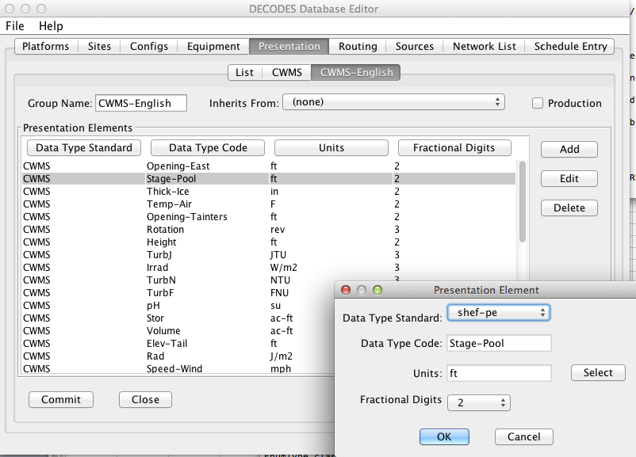
Improved Presentation Groups

Slide 11
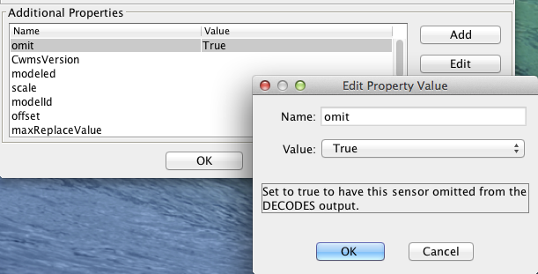
Improved Properties Panels
Tool tips & type-checking takes the guess-work out of setting various properties in DECODES and CCP.

Slide 12
Conclusion
Cove offers:
  Maintenance/Support Contracts
  Custom integration & programming
  Training
Cove Software will be around for many years and will grow.
OpenDCS has many new enhancements not available from other vendors.
  Many more features planned over the next year
  Let me know if you would like something added to the product Road Map

Slide 13
Contact
Cove Software, LLC
  Email: info@covesw.com
  Web: www.covesw.com
  Tel (410) 715-1117

